Slide 1
The Generation H Project
Funded by European Union
A multi-intervention project to combat unhealthy diets and physical inactivity among adolescents in Sub Saharan Africa

Slide 2
Content of this presentation
Funded by European Union
Background
Work Packages & partners
Key objectives
Project operationalization & Timeline
Status of the project
Dissemination

Slide 3
Background
Funded by European Union
The rising burden of non-communicable diseases (NCDs) is a global health concern.
To reduce the burden of morbidity, mortality and disability due to NCDs, the World Health Organization (WHO) developed ‘best buys’ and other interventions for the prevention and control of NCDs by member countries.
However, their implementation and evaluation is suboptimal, especially in sub-Saharan African countries.
Gen H project aims to reduce unhealthy diets and physical inactivity and their underlying social determinants among adolescents in Ghana & Kenya by designing, deploying, and evaluating the strategies for implementation of evidenced interventions mapped on to the WHO ‘best buys’.

Slide 4
Suistainable Development Goals (SDG)
Funded by European Union
The Generation H project contributes to the following Sustainable Development Goals of the UN:

Slide 5
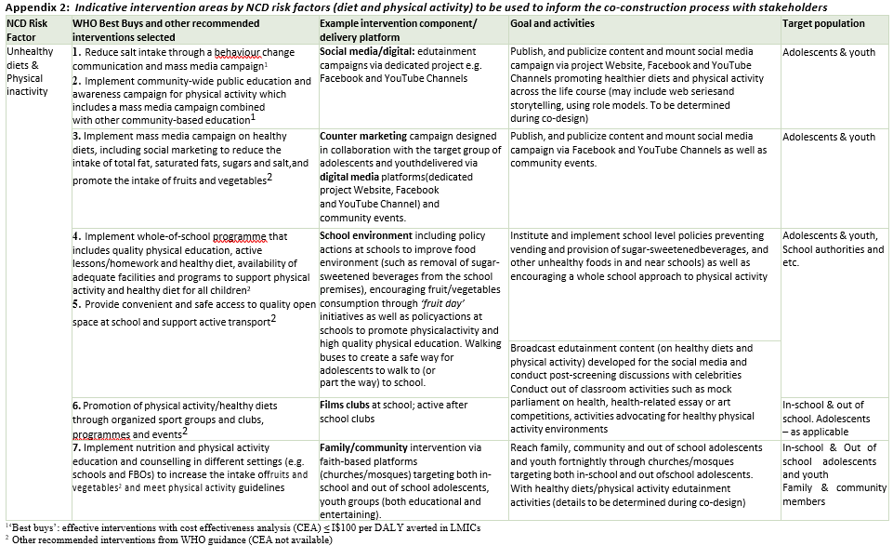
Best buys of the WHO
Funded by European Union
Four key risk factors for NCDs: tobacco, harmful use of alcohol, unhealthy diet and physical inactivity
Notes:
Table shows 3 categories of interventions:
⎯⎯Out of the 88 interventions, there are a total of 16 “best buys” – those considered the most cost-effective and feasible for implementation. These are interventions where a WHO Choice analysis found an average cost-effectiveness ratio of ≤ I$ 100 per DALY averted in low- and lower middle-income countries.
⎯⎯Other effective interventions for which the WHO Choice analysis produced a cost effectiveness of of > I$2 100 per DALY averted are shown in the second category.
⎯⎯The third category shows other recommended interventions that have been shown to be effective but for which no cost-effective analysis was conducted.
In Generation H we will Focus in particular on BB4 and BB7

Slide 6
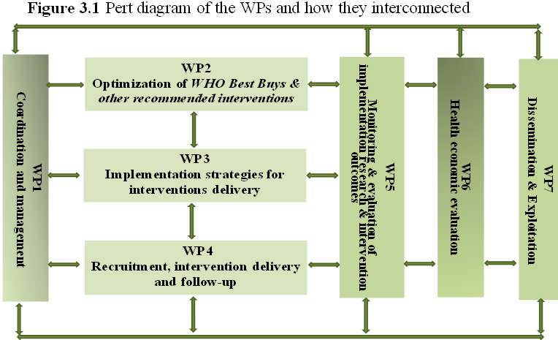
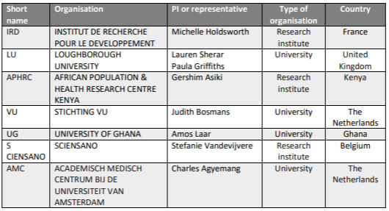
Work packages & leads
Funded by European Union

Slide 7
The specific objectives of Generation H
Funded by European Union
To adapt and optimise evidence-based interventions that map onto 7 WHO Best Buys for unhealthy diet & physical inactivity with the relevant stakeholders in education, health, the community and target group for use amongst adolescents ensuring that they are culturally acceptable, equitable and scalable within 2 years (WP2);
To co-create effective implementation strategies and tools with the relevant stakeholders for the delivery of the interventions, ensuring that they are culturally acceptable, equitable and scalable within 2 years (WP3);
To recruit the target population from different socio-economic backgrounds & deliver interventions focusing on three settings: school environment, family/community/ faith-based environment & digital environment using social media and follow them up in months 6 & 18 (WP4);
To determine whether the implementation strategies developed for the delivery of optimised interventions influence i. implementation level outcomes (e.g., acceptability, adoption, appropriateness,) and ii. uptake of promoted healthy behaviours (improvements in knowledge, attitude & practice of dietary behaviours, food environment, physical activity; and anthropometric indices, self-efficacy, health literacy and psychosocial stress in a short-term (6 month) and a long-term (18 months) (WP5);
To conduct a health economic analysis of the implementation of the optimized interventions to determine whether the implementation strategies for the delivery of the interventions are cost-effective (WP6);
To disseminate and exploit the study findings through engagement of local, national, and regional experts and policy makers in translating and embedding the findings into practice and policy in Ghana and Kenya and other SSA countries and beyond throughout the project cycle and beyond (WP7).

Slide 8
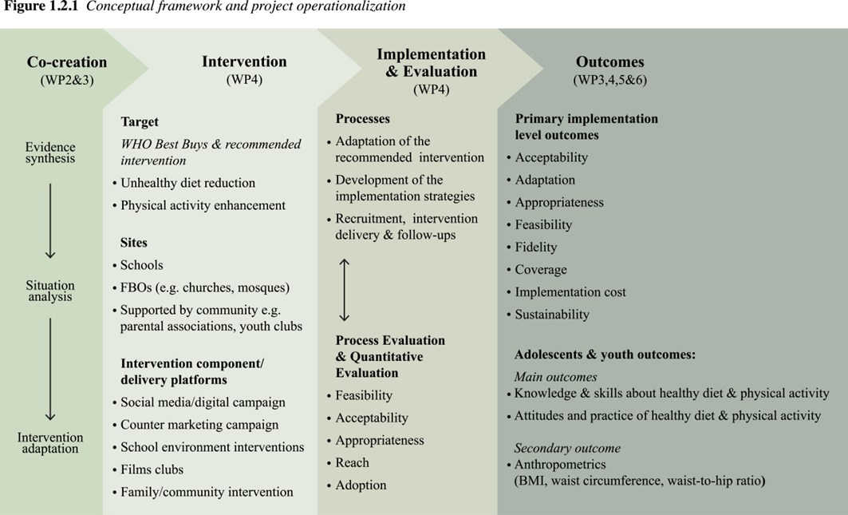
Project operationalization
Funded by European Union
Notes:
THE INTERVENTION DEVELOPMENT WILL COMPRISE: THE INTERVENTION PLANNING – DESIGN & DEVELOPMENT - INTERVENTION IMPLEMENTATION & EVALUATION
Cocreation: The intervention will be co-designed & co-developed, and co-implemented with relevant stakeholders and implementing partners as well as the primary target population (adolescents) → participation is key!
Intervention: It will be a Complex Intervention, consisting of a. several components (PA+Diet) and b. targeting muliple levels of delivery (Individual + family/community + policy) → socio-ecological model
Implementation: Ultimately, these components together aim to increase awareness, knowledge & skills, motivation self efficacy, self regulatory actions, and positive health behaviour + health outcomes
& Evaluation will focus on: Process of intervention development and implementation strategies + implementation of the intervention + Effect on Implementation outcomes; Behavioural outcomes; Health outcomes
………………………………………
Evidenced by:
a. Several components→ Combining interventions focussed on healthy Diet and PA have been identified as efficient approaches in children to decrease incidence of obesity/chronic morbidities
b. Muliple levels of delivery: digital - , School-, Family/Community/Faith Based envionment.

Slide 9
Design
Funded by European Union
Mixed methods, Hybrid design type 3 (more weight on implementation outcomes than on effectiveness outcome)
WP2: Realist review - Stakeholder consultations - Co-production – Prototyping (MRC)
WP3: Implementation Mapping, Community based participatory approach
WP4-5-6: Pre-post repeated cross-sectional design (Qual & Quant: 0, 6, 18 months)
Process-Implementation-Behavioral-Health-Health economic outcomes.
Study population
Adolescents (10-19 yr) in primary and secondary schools & Faith-Based Organizations, and stakeholders in education-health-community leadership in Accra, Ghana & Nairobi, Kenya
Notes:
- Realist review - Stakeholder consultations - Co-production – Prototyping → derived from the MRC Complex interventions
- Limitation of the effectiveness evaluation: No control group (clinical trial). Reason behind:
Focus should be on implementation → flexible/iterative approach → RCT is often very protocolized and inflexible
Social intervention strategies → contamination (leakage)
The intervention will be co-designed & co-developed, and co-implemented with relevant stakeholders and implementing partners as well as the primary target population (adolescents)
→ MRC framework for Complex interventions + Experience Based Co design approach for developing and implementing the intervention together)

Slide 10
Sample size
Funded by European Union
Outcome | Baseline | End-line | Change | Sample size
Fruit consumption | 28.8% | 36.1% | 25.3% | 2130
Veg consumption | 2.7% | 6.3% | 113% | 1717
SSB consumption | 22.5% | 14.3% | 36.4% | 1155
Physical Activity | 38.7% | 53.0% | 36.8% | 630
Assumptions based on a study in Eldoret, Kenya, sample size adjusted for design effect 1.5, correlation pre- and post,0.3, attrition
Notes:
Primary outcome based on knowledge and behavior change in PA/Diet → change in proportion of adolescents whose behavior changed during the intervention
10 schools: 7 primary (10-13 yr grade 6-8) and 3 secondary (14-18 yr, grade 9-12)
In each study district 50 schools and 140 adolescents in each school
Non response rate 25-10%
Minimum adjusted sample size: 2343 → each country will select 2400 adolescents at baseline

Slide 11
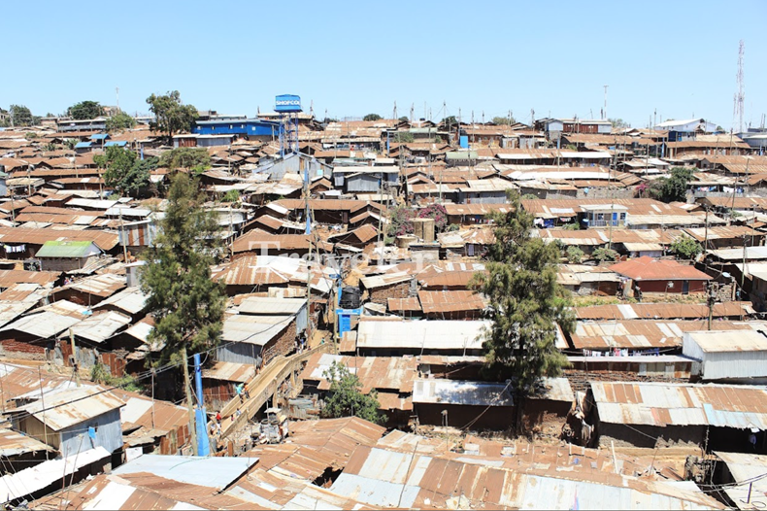
High SES
Study location - Kenya
Funded by European Union
Low SES
Buruburu (Nairobi)
Kibra (Nairobi)
Notes:
Study Area
THE ROLE OF CONTEXT IS IMPORTANT IN THIS STUDY!! → High and Low SES urban environment in two SSA countries Kenya and Ghana
Equal to Kenya: two study locations have been selected in Accra, Ghana.

Slide 12
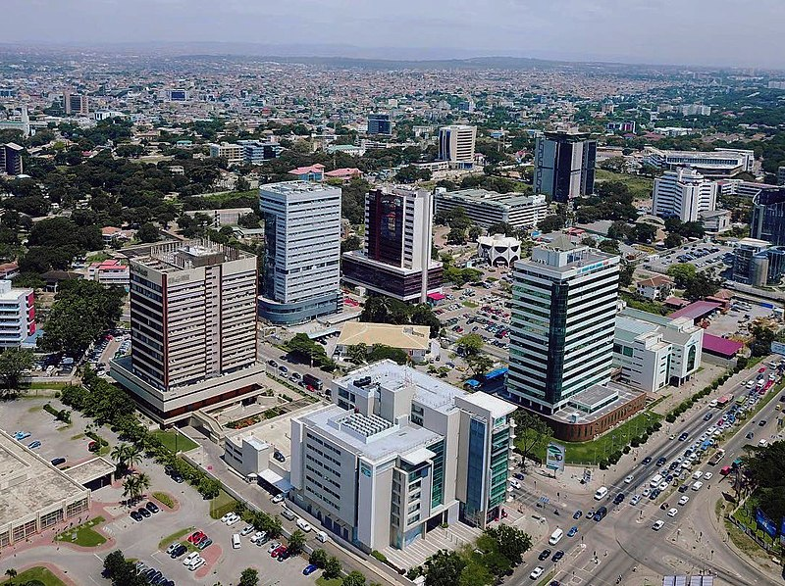
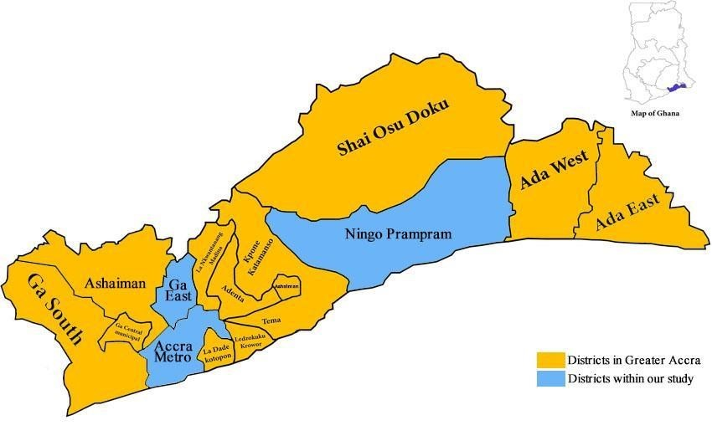
High SES
Study location - Ghana
Funded by European Union
Low SES
Ayawaso west
Ga East

Slide 13
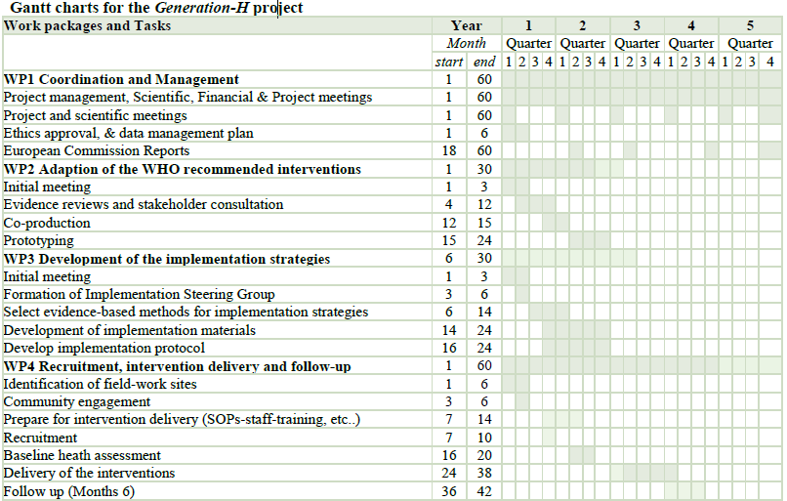
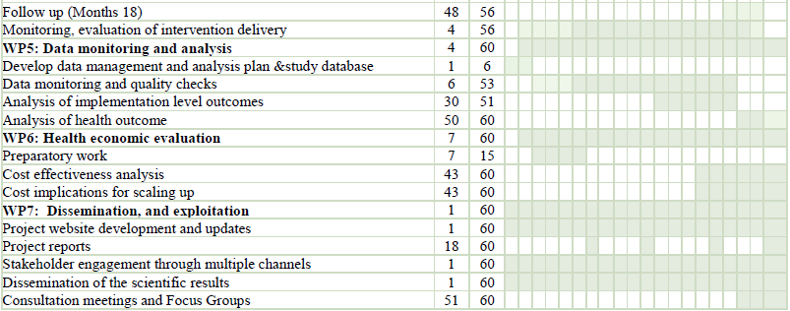
Time frame &
Duration of the project
Notes:
OVERVIEW OF THE PROJECT: WORK PACKAGES AND SEVERAL STAGES + TASKS INVOLVED + PLANNING
→ JUST FINISHED Q1: at the very start of the project!

Slide 14
Status (10 months)
Funded by European Union
WP1: Collaboration → 2-days Kick off meeting + 2 online Steering Group meetings
WP1: Advisory Board
WP1: Communication structure
WP1: Recruitment of staff (Amsterdam UMC: RA & 2 PhD-students)
WP2: Rapid Realist Review, PROSPERO
WP4: Institutional Ethics Approvals (Kenya & Ghana)
WP5: Data management plan, Protocol paper, Publication guidelines, Project Management Handbook & Data Analysis Plan
WP7: Project website, Communication and Dissemination plan & Press release Amsterdam UMC and IRD
(1) PROSPERO: International prospective register of systematic reviews: “What interventions work for whom, and under what circumstances, to promote healthy diets and/or physical activity of among adolescents: protocol for a rapid realist review in Sub-Saharan Africa” crd.york.ac.uk/prospero/display_record.php?RecordID=537862

Slide 15
WP7 – Dissemination-Plan (1)
Funded by European Union
Dissemination channels per target audience
Area of impact | Key results of interest | Aim | Means
Scientists | Scientific basis Strategies for implementation Project outcomes Cost-effectiveness | Uptake of project results Leveraging output to other NCD research fields Conduct research in other SSA countries Engagement for project input | At least 10 open access scientific publications At least 20 presentations at scientific conferences e.g., African Nutrition Society, FERN, PASCAR, EUPHA Peer-to-peer interactions Social media (X, Facebook, LinkedIn) Press release/interviews in newspapers, magazines and possibly national television
Professional organisations | Scientific basis & project outcomes Cost-effectiveness | Uptake of project results Implementation strategies Engagement for project input | At least 10 Open access scientific publications At least 20 Scientific conferences Social media (X, Facebook, LinkedIn)
Community organisations | Scientific basis & main findings Culturally tailored information for lifestyle changes Training materials | Commitment to the project Commitment to wide post- project implementation Capacity building of the community staff Engagement for project input | Generation H project website Information material (brochure/flyer) Social media (Facebook, X etc.) Media e.g. newspapers & TV Site visits & Training events
Notes:
Will be developed further and in more detail coming months (Deliverable M6)
Scientists:
Did anyone heard about the project so far?
Did you notice the press releases?
Any suggestions for communications to the scientific community (you)?

Slide 16
WP7 – Dissemination-Plan (2)
Funded by European Union
Dissemination channels per target audience
Area of impact | Key results of interest | Aim | Means
Policymakers & public health authorities | Scientific basis & strategies for implementation Methods & tools Medium and long-term impact of the project Cost-effectiveness | Implementation of Generation H results into policy Enhanced efforts for NCDs prevention Inclusion of adolescents in policy landscape Engagement for project input | Generation H project website 3 monthly newsletter throughout project Dissemination meetings – study outcomes Open access scientific publication Liasing with international governments which have wide reach and influence Policy briefs
Advocacy groups | Main aims and findings Strategies for implementation Health and quality of life impact | Foster advocacy for NCDs prevention in young people Commitment to post-project implementation Engagement for project input | Generation H project website Periodic newsletter throughout project Meeting with patient advocacy groups Dissemination meetings – study outcomes
Advisory Board | Scientific basis Methods & tools Strategies for implementation Project outcomes Cost-effectiveness | Provide advice on the project Foster advocacy for NCDs prevention in young people Commitment to post-project implementation Engagement for project input | Generation H project meetings Periodic newsletter throughout project Social media (X, Facebook, LinkedIn) Dissemination meetings – study outcomes Project website
Citizens/general society/youth groups | Main aims and findings Health and quality of life impact | Uptake of project results Engagement for project input | Social media (X, Facebook, LinkedIn) Press release/interviews in Newspapers, magazines and pssibly national television Generation H project website

Slide 17
Thank you
Funded by European Union
For further details about the Generation H project and opportunities for engagement, please visit our website: https://www.generationh.org/

